Slide 1
Impedance Parameters OR Z-Parameters OR Open Circuit Parameters

Slide 2
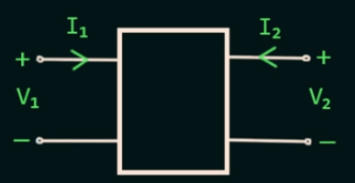

Z-Parameters OR Impedance Parameters
We know 4 Variables in Two Port Network I₁ ,I₂, V₁ and V₂
2 Variables are Independent and 2 Variables are Dependent.
I₁ is the current at Port 1 and I₂ is the current at Port 2
Similarly V₁ is the Voltage at Port1 and V₂ is the Voltage at Port 2.
$$V_{1}\text{ = }I_{1}Z_{11}\text{+ }{Z_{12}I}_{2}$$
$$V_{1}\text{ = }Z_{11}I_{1} \text{+ }{Z_{12}I}_{2}\text{ (}\text{1)}$$
$$V_{2}\text{ = }{I_{2}Z}_{22}\text{ + }Z_{21}I_{1}$$
${ V}_{2}\text{ =}Z_{21}I_{1}+ Z_{22}I_{2}$ (2)

Slide 3
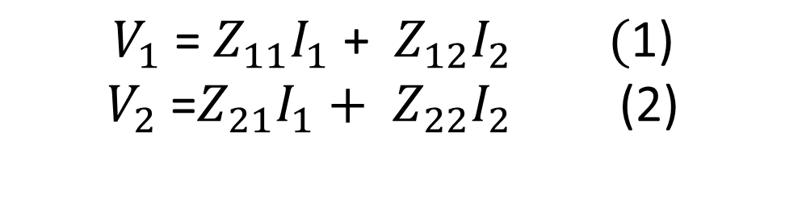
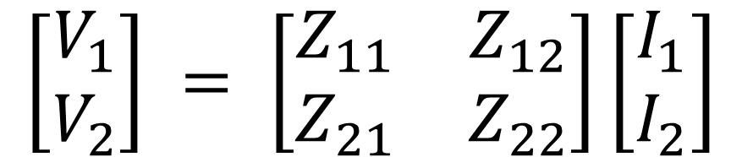

$$V_{1}\text{ = }Z_{11}I_{1} \text{+ }{Z_{12}I}_{2}\text{ (}\text{1)}$$
$$V_{2}\text{ =}Z_{21}I_{1}+ Z_{22}I_{2} \text{ (2)}$$
Convert equation (1) and (2) into matrix form
$$\left[\begin{aligned}V_{1} \\ V_{2}\end{aligned}\right] = \left[\begin{matrix}Z_{11} & Z_{12} \\ Z_{21} & Z_{22}\end{matrix}\right]\left[\begin{aligned}I_{1} \\ I_{2}\end{aligned}\right]$$
Voltage Matrix
Impedance Matrix
Current Matrix
$$\left[V\right] = \left[Z\right]\left[I\right]$$

Slide 4
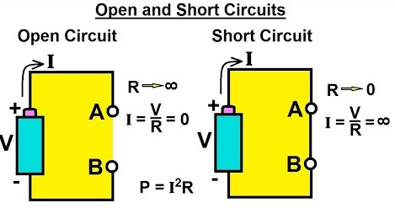
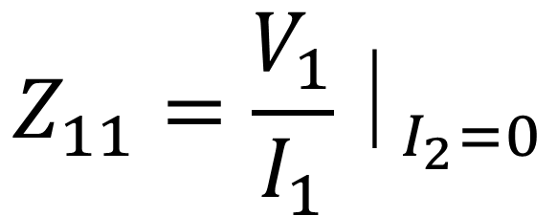
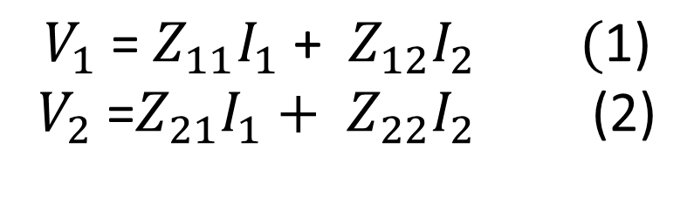
$$V_{1}\text{ = }Z_{11}I_{1} \text{+ }{Z_{12}I}_{2}\text{ (}\text{1)}$$
$$V_{2}\text{ =}Z_{21}I_{1}+ Z_{22}I_{2} \text{ (2)}$$
From equation (1) , If I₂ is equal to Zero than Z₁₁
$$Z_{11}=\frac{V_{1}}{I_{1}}⏐_{I_{2}=0}$$
V₁ divided by I₁ , when port 2 is open circuited
It is also called as Input Impedance with the output port open circuited

Slide 5
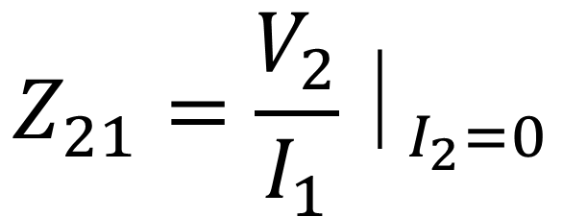
$$V_{1}\text{ = }Z_{11}I_{1} \text{+ }{Z_{12}I}_{2}\text{ (}\text{1)}$$
$$V_{2}\text{ =}Z_{21}I_{1}+ Z_{22}I_{2} \text{ (2)}$$
Similarly equation (2) , If I₂ is equal to Zero than Z₂₁
$$Z_{21}=\frac{V_{2}}{I_{1}}⏐_{I_{2}=0}$$
V₂ divided by I₁ , when port 2 is open circuited
It is also called as Forward Transfer Impedance with the output is port open circuited

Slide 6
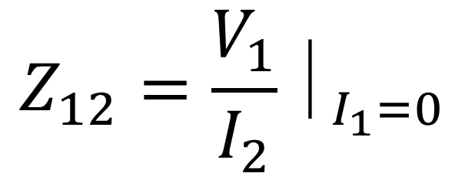
$$V_{1}\text{ = }Z_{11}I_{1} \text{+ }{Z_{12}I}_{2}\text{ (}\text{1)}$$
$$V_{2}\text{ =}Z_{21}I_{1}+ Z_{22}I_{2} \text{ (2)}$$
Similarly equation (1) , If I₁ is equal to Zero than Z₁₂
$$Z_{12}=\frac{V_{1}}{I_{2}}⏐_{I_{1}=0}$$
V₁ divided by I₂ , when port 1 is open circuited
It is also called as Open Circuit Inverse Transfer Impedance
It is also called as Reverse Transfer Impedance with the Input Port is Open Circuited

Slide 7
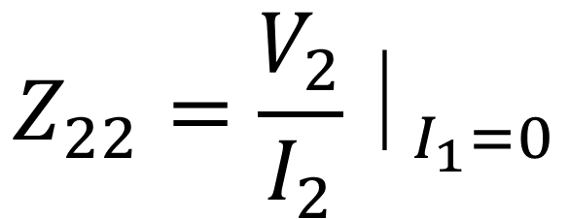
$$V_{1}\text{ = }Z_{11}I_{1} \text{+ }{Z_{12}I}_{2}\text{ (}\text{1)}$$
$$V_{2}\text{ =}Z_{21}I_{1}+ Z_{22}I_{2} \text{ (2)}$$
Similarly equation (2) , If I₁ is equal to Zero than Z₂₂
$$Z_{22}=\frac{V_{2}}{I_{2}}⏐_{I_{1}=0}$$
V₂ divided by I₂ , when port 1 is open circuited
It is also called as Output Impedance with the Input Port is Open Circuited

Slide 8
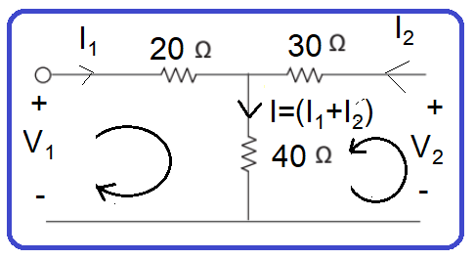


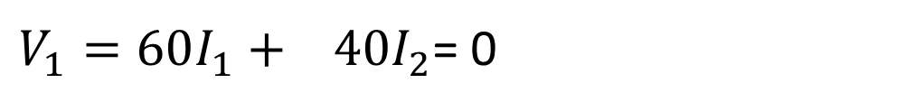

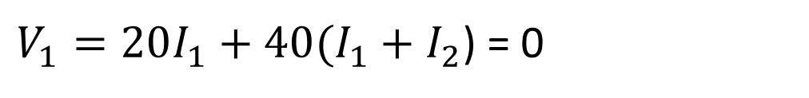

Q: Determine the Z-Parameter for the given circuit below
Solution: From Original Equation of Z-Parameters
$$V_{1}=Z_{11}I_{1}+ Z_{12}I_{2}$$
$$V_{2}=Z_{21}I_{1}+ Z_{22}I_{2}$$
Take Loop 1
$V_{1}=20I_{1}+40(I_{1}+I_{2}$)
Because both currents have same direction and in the branch , so due to this we add both currents.
$V_{1}=20I_{1}+40(I_{1}+I_{2}$) = 0
$V_{1}=60I_{1}+ 40I_{2}$= 0
$$Z_{11}=60,Z_{12}=40$$
$$V_{1}=Z_{11}I_{1}+ Z_{12}I_{2}$$

Slide 9





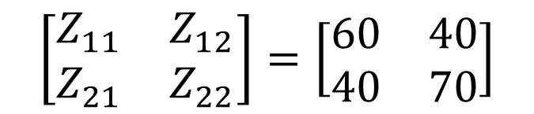


Original Equation of Z-Parameters
$$V_{1}=Z_{11}I_{1}+ Z_{12}I_{2}$$
$$V_{2}=Z_{21}I_{1}+ Z_{22}I_{2}$$
Take Loop 2,
$V_{2}=30I_{2}+40(I_{1}+I_{2}$)
$$V_{2}=30I_{2}+40I_{1} −40I_{2}$$
$$V_{2}=40I_{1}+70I_{2}$$
$$\left[\begin{matrix}Z_{11} & Z_{12} \\ Z_{21} & Z_{22}\end{matrix}\right]=\left[\begin{matrix}60 & 40 \\ 40 & 70\end{matrix}\right]$$
$$V_{2}=40I_{1}+ 70I_{2}$$
$$Z_{21}=40,Z_{22}=70$$
$$V_{2}=Z_{21}I_{1}+ Z_{22}I_{2}$$

Slide 10



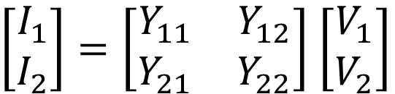


Admittance Parameters OR Y-Parameters OR Short Circuit Parameters
$$V_{1}=Z_{11}I_{1}+ Z_{12}I_{2}$$
$$V_{2}=Z_{21}I_{1}+ Z_{22}I_{2}$$
Simply Changes Voltages into currents, Currents into voltages and Impedances changes into Admittances
$$I_{1}=Y_{11}V_{1}+ Y_{12}V_{2}$$
$$I_{2}=Y_{21}V_{1}+ Y_{22}V_{2}$$
Convert into Matrix Form
$\left[\begin{matrix}I_{1} \\ I_{2}\end{matrix}\right]=\left[\begin{matrix}Y_{11} & Y_{12} \\ Y_{21} & Y_{22}\end{matrix}\right]$ $\left[\begin{matrix}V_{1} \\ V_{2}\end{matrix}\right]$
$\left[I\right]=\left[Y\right]$ $\left[V\right]$

Slide 11



Calculate Y₁₁ , so V₂ is zero, when voltage is zero means it is Shor Circuited
$$I_{1}=Y_{11}V_{1}+ Y_{12}V_{2}$$
$$I_{1}=Y_{11}V_{1}+0$$
$$I_{2}=Y_{21}V_{1}+ Y_{22}V_{2}$$
$$Y_{11}=\frac{I_{1}}{V_{1}}⏐_{V_{2=0}} Short Circuit Driving Point Input Admittance$$
$$Y_{21}=\frac{I_{2}}{V_{1}}⏐_{V_{2=0}} Short Circuit Forward Transfer Admittance$$
$$Y_{12}=\frac{I_{1}}{V_{2}}⏐_{V_{1=0}} Short Circuit Reverse Transfer Admittance$$
$$Y_{22}=\frac{I_{2}}{V_{2}}⏐_{V_{1=0}} Short Circuit Driving Point Output Admittance$$

Slide 12
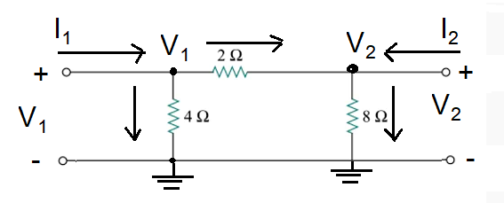


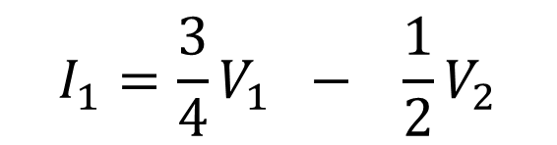


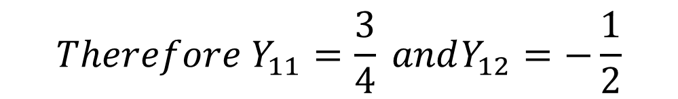
Q: Determine the Y-Parameter for the given circuit below
$$I_{1}=Y_{11}V_{1}+ Y_{12}V_{2}$$
$$I_{2}=Y_{21}V_{1}+ Y_{22}V_{2}$$
$$At Node No:1$$
$$I_{1}=\frac{{(V}_{1}−0)}{4}+\frac{{(V}_{1}−V_{2})}{2}=\frac{V_{1}}{4}+\frac{V_{1}}{2} −\frac{V_{2}}{2}=\left(\frac{1}{4}+\frac{1}{2}\right)V_{1}−\frac{1}{2}V_{2}=\frac{3}{4}V_{1}−\frac{1}{2}V_{2}$$
$$I_{1}=\frac{3}{4}V_{1} − \frac{1}{2}V_{2}$$
$${Therefore Y}_{11}=\frac{3}{4} andY_{12}=−\frac{1}{2}$$
$$I_{1}=Y_{11}V_{1}+ Y_{12}V_{2}$$

Slide 13
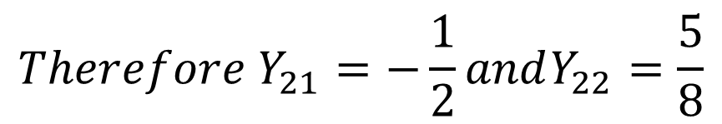



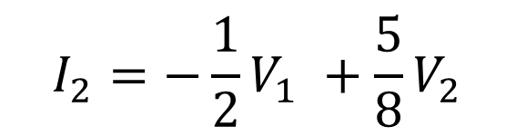

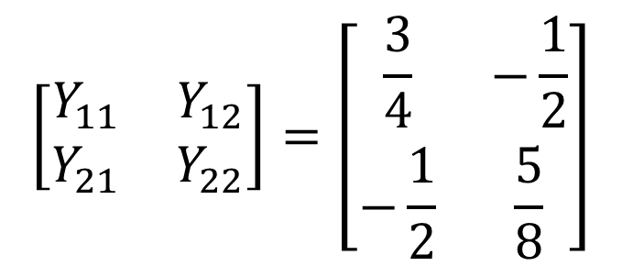
$$I_{1}=Y_{11}V_{1}+ Y_{12}V_{2}$$
$$At Node No:2$$
$$I_{2}=Y_{21}V_{1}+ Y_{22}V_{2}$$
$$I_{2}=\frac{{(V}_{2}−0)}{8}+\frac{{(V}_{2}−V_{1})}{2}=\frac{V_{2}}{8}+\frac{V_{2}}{2} −\frac{V_{1}}{2}=\left(\frac{1}{8}+\frac{1}{2}\right)V_{2}−\frac{1}{2}V_{1}=\frac{5}{8}V_{2}−\frac{1}{2}V_{1}$$
$$I_{2}=−\frac{1}{2}V_{1} +\frac{5}{8}V_{2}$$
$${Therefore Y}_{21}=−\frac{1}{2}andY_{22}=\frac{5}{8}$$
$$I_{1}= Y_{21}V_{1}+ Y_{22}V_{2}$$
$$\left[\begin{matrix}Y_{11} & Y_{12} \\ Y_{21} & Y_{22}\end{matrix}\right]=\left[\begin{matrix}\frac{3}{4} & −\frac{1}{2} \\ −\frac{1}{2} & \frac{5}{8}\end{matrix}\right]$$

Slide 14


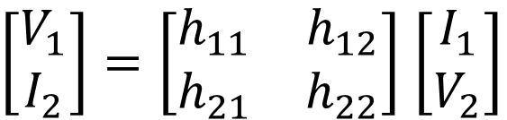


Hybrid-Parameters or h-Parameters
$$V_{1}=Z_{11}I_{1}+ Z_{12}I_{2}$$
$$V_{2}=Z_{21}I_{1}+ Z_{22}I_{2}$$
To generate the h-parameter, simply output side variables of current with voltage and voltage with currents only I₂ = V₂ , V₂ = I₂ and Z = h
$$V_{1}=h_{11}I_{1}+ h_{12}V_{2}$$
$$I_{2}=h_{21}I_{1}+ h_{22}V_{2}$$
Convert into Matrix Form
$\left[\begin{matrix}V_{1} \\ I_{2}\end{matrix}\right]=\left[\begin{matrix}h_{11} & h_{12} \\ h_{21} & h_{22}\end{matrix}\right]$ $\left[\begin{matrix}I_{1} \\ V_{2}\end{matrix}\right]$

Slide 15
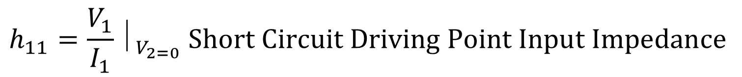

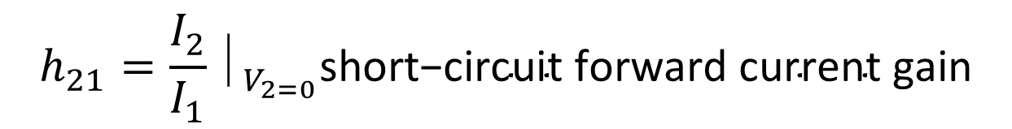

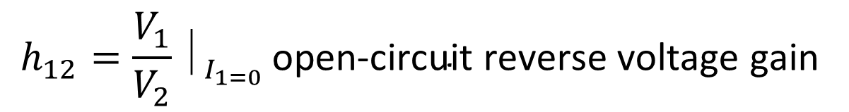
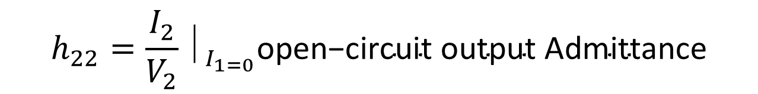
$$V_{1}=h_{11}I_{1}+ h_{12}V_{2}$$
$$I_{2}=h_{21}I_{1}+ h_{22}V_{2}$$
$$h_{11}=\frac{V_{1}}{I_{1}}⏐_{V_{2=0}} Short Circuit Driving Point Input Impedance$$
$$OR \text{ratio} \text{of} \text{input} \text{voltage} \text{to} \text{input} \text{current}\text{, }\text{at} \text{short} \text{circuited} \text{output} \text{port}$$
$$h_{22}=\frac{I_{2}}{V_{2}}⏐_{I_{1=0}}\text{open}\text{−}\text{circuit} \text{output} \text{Admittance}$$
$$h_{12}=\frac{V_{1}}{V_{2}}⏐_{I_{1=0} }\text{open}\text{−}\text{circuit} \text{reverse} \text{voltage} \text{gain}$$
$$h_{21}=\frac{I_{2}}{I_{1}}⏐_{V_{2=0}}\text{short}\text{−}\text{circuit} \text{forward} \text{current} \text{gain}$$

Slide 16
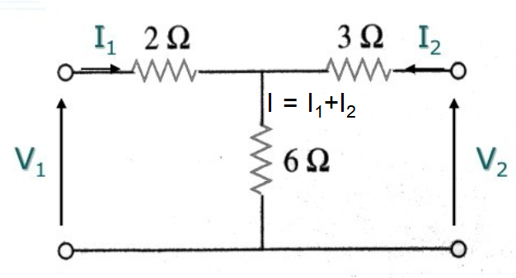
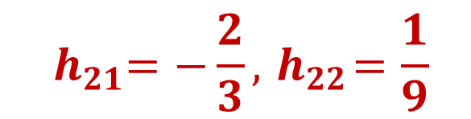
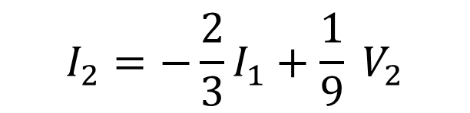
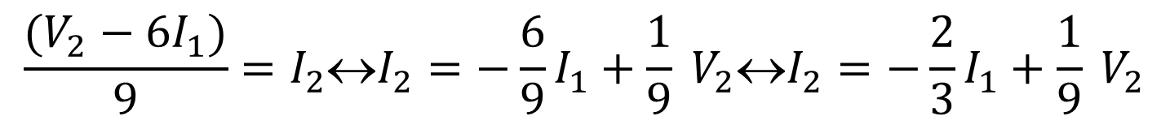




Q: Determine the h-Parameter for the given circuit below
$$V_{1}=h_{11}I_{1}+ h_{12}V_{2}$$
$$I_{2}=h_{21}I_{1}+ h_{22}V_{2}$$
$$At Node No:2$$
$V_{2}−3I_{2}−6\left(I_{1}+I_{2}\right)=0↔V_{2}=3I_{2}+6\left(I_{1}+I_{2}\right)↔V_{2}=6I_{1}+9I_{2}$ $V_{2}−6I_{1}=9I_{2}$
$$\frac{(V_{2}−6I_{1})}{9}=I_{2}↔I_{2}=−\frac{6}{9}I_{1}+\frac{1}{9} V_{2}↔I_{2}=−\frac{2}{3}I_{1}+\frac{1}{9} V_{2}$$
$$I_{2}=−\frac{2}{3}I_{1}+\frac{1}{9} V_{2}$$
$${ h}_{21}=−\frac{2}{3},{ h}_{22}=\frac{1}{9}$$
$$I_{2}={ h}_{21}I_{1}+ h_{22}V_{2}$$

Slide 17

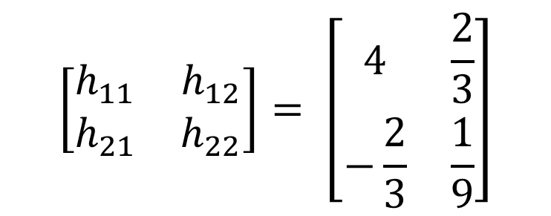

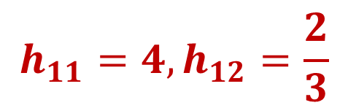



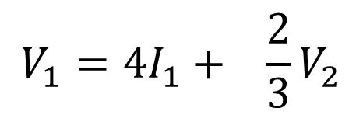
$$V_{1}=h_{11}I_{1}+ h_{12}V_{2}$$
$$I_{2}=h_{21}I_{1}+ h_{22}V_{2}$$
$$At Node No:1$$
$$V_{1}−2I_{1}−6\left(I_{1}+I_{2}\right)=0↔V_{1}=2I_{1}+6\left(I_{1}+I_{2}\right)↔V_{1}=2I_{1}+6I_{1}+6I_{2}$$
$$V_{1}=8I_{1}+ 6I_{2} −−−−−−(A)$$
Put the value of I₂
$V_{1}=8I_{1}+6(−\frac{2}{3}I_{1}+\frac{1}{9} V_{2})↔$ $V_{1}=8I_{1}−4I_{1}+\frac{2}{3}V_{2}↔ V_{1}=4I_{1}+\frac{2}{3}V_{2}$
$$V_{1}=4I_{1}+ \frac{2}{3}V_{2}$$
$$\left[\begin{matrix}h_{11} & h_{12} \\ h_{21} & h_{22}\end{matrix}\right]= \left[\begin{matrix}4 & \frac{2}{3} \\ −\frac{2}{3} & \frac{1}{9}\end{matrix}\right]$$
$$h_{11}=4,h_{12}=\frac{2}{3}$$
$$V_{1}=h_{11}I_{1}+ h_{12}V_{2}$$

Slide 18
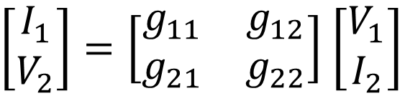


Inverse Hybrid or g-Parameters
$$V_{1}=Z_{11}I_{1}+ Z_{12}I_{2}$$
$$V_{2}=Z_{21}I_{1}+ Z_{22}I_{2}$$
To generate the inverse h-parameter, simply input side variables of current with voltage and voltage with currents only V₁ = I₁ and Z = g
$$I_{1}=g_{11}V_{1}+ g_{12}I_{2}$$
$$V_{2}=g_{21}V_{1}+ g_{22}I_{2}$$
Convert into Matrix Form
$\left[\begin{matrix}I_{1} \\ V_{2}\end{matrix}\right]=\left[\begin{matrix}g_{11} & g_{12} \\ g_{21} & g_{22}\end{matrix}\right]$ $\left[\begin{matrix}V_{1} \\ I_{2}\end{matrix}\right]$

Slide 19

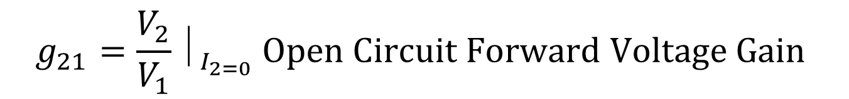
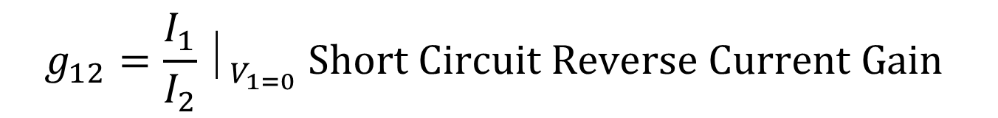
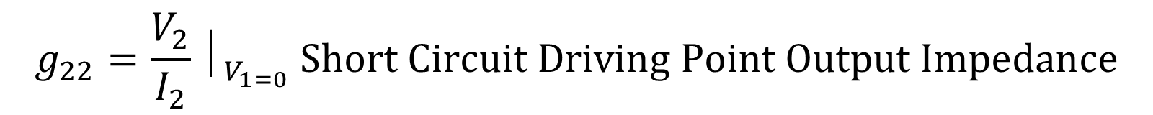

$$I_{1}=g_{11}V_{1}+ g_{12}I_{2}$$
$$V_{2}=g_{21}V_{1}+ g_{22}I_{2}$$
$$g_{11}=\frac{I_{1}}{V_{1}}⏐_{I_{2=0}} Open Circuit Driving Point Input Admittance$$
$$g_{22}=\frac{V_{2}}{I_{2}}⏐_{V_{1=0}} Short Circuit Driving Point Output Impedance$$
$$g_{12}=\frac{I_{1}}{I_{2}}⏐_{V_{1=0}} Short Circuit Reverse Current Gain$$
$$g_{21}=\frac{V_{2}}{V_{1}}⏐_{I_{2=0}} Open Circuit Forward Voltage Gain$$

Slide 20
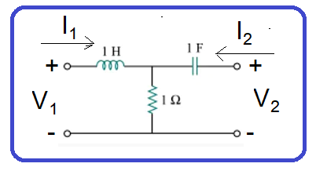
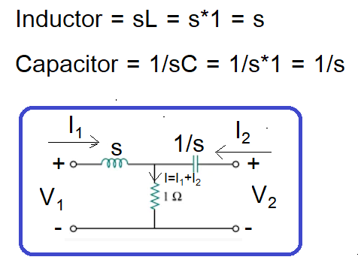


$$I_{1}=g_{11}V_{1}+ g_{12}I_{2}$$
$$V_{2}=g_{21}V_{1}+ g_{22}I_{2}$$
Circuit change into s-domain

Slide 21
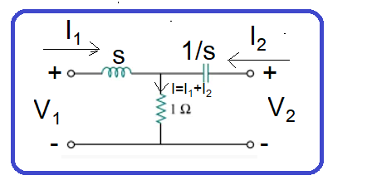
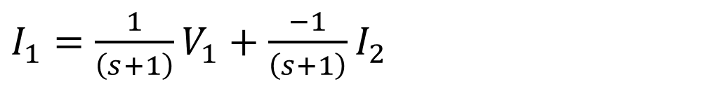

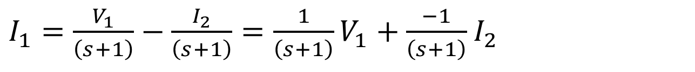

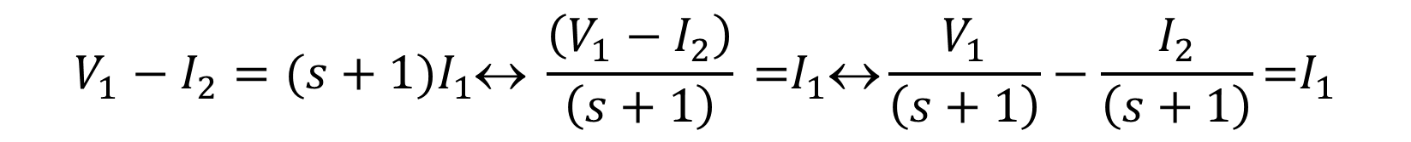


$$I_{1}=g_{11}V_{1}+ g_{12}I_{2}$$
$$V_{2}=g_{21}V_{1}+ g_{22}I_{2}$$
Branch-1
$V_{1}= I_{1}∗s+1∗\left(I_{1}+I_{2}\right)$↔ $V_{1}=sI_{1}+I_{1}+I_{2}\text{↔} V_{1}=({s+1)I}_{1}+I_{2}$
$$V_{1}−I_{2}=({s+1)I}_{1}\text{↔} \frac{\left(V_{1}−I_{2}\right)}{\left(s+1\right)}\text{ =}I_{1}\text{↔}\frac{V_{1}}{\left(s+1\right)}−\frac{I_{2}}{\left(s+1\right)}\text{=}I_{1}$$
$I_{1}=\frac{V_{1}}{\left(s+1\right)}−\frac{I_{2}}{\left(s+1\right)}=\frac{1}{\left(s+1\right)}V_{1}+\frac{−1}{\left(s+1\right)}$ $I_{2}$
$I_{1}=\frac{1}{\left(s+1\right)}V_{1}+\frac{−1}{\left(s+1\right)}$ $I_{2}$
$$g_{11}=\frac{1}{s+1},g_{12}=−\frac{1}{s+1}$$
$$I_{1}=g_{11}V_{1}+ g_{12}I_{2}$$

Slide 22
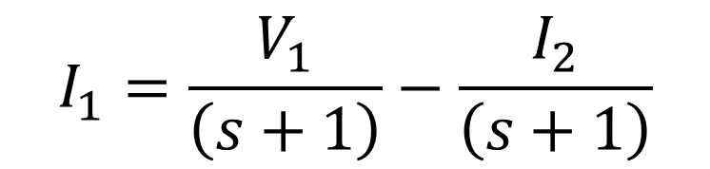
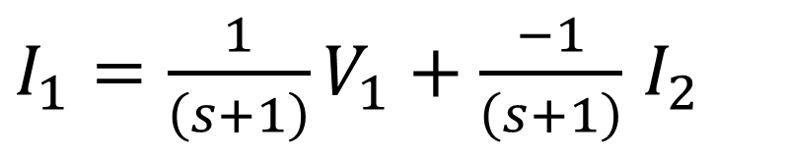
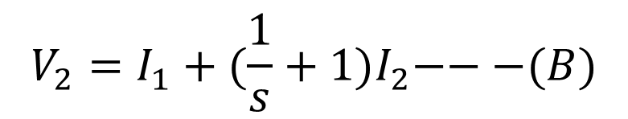
$I_{1}=\frac{1}{\left(s+1\right)}V_{1}+\frac{−1}{\left(s+1\right)}$ $I_{2}$
$$I_{1}=\frac{V_{1}}{\left(s+1\right)}−\frac{I_{2}}{\left(s+1\right)}$$
Branch-2
$V_{2}=\frac{1}{s}I_{2}+1∗\left(I_{1}+I_{2}\right)$↔ $V_{2}=\frac{1}{s}I_{2}+I_{1}+I_{2}\text{↔} V_{2}=I_{1}+{(\frac{1}{s}+1)I}_{2})$
$$V_{2}=I_{1}+{(\frac{1}{s}+1)I}_{2}−−−(B)$$
Put the Value of I₁ in eq (B)
$$V_{2}=\left\{\frac{V_{1}}{\left(s+1\right)}−\frac{I_{2}}{\left(s+1\right)}\right\}+{\left(\frac{1}{s}+1\right)I}_{2}=\frac{V_{1}}{\left(s+1\right)}−\frac{I_{2}}{\left(s+1\right)}+{\left(\frac{1}{s}+1\right)I}_{2}$$
$$V_{2}=\frac{V_{1}}{\left(s+1\right) }−\frac{I_{2}}{\left(s+1\right)}+\frac{I_{2}}{s}{+I}_{2}=\frac{V_{1}}{\left(s+1\right) }{+I}_{2}+\frac{I_{2}}{s} −\frac{I_{2}}{\left(s+1\right)}$$

Slide 23

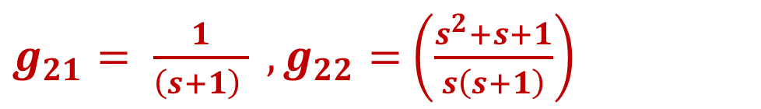
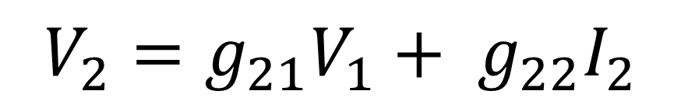
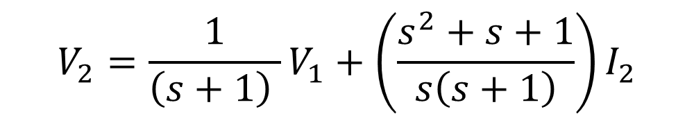
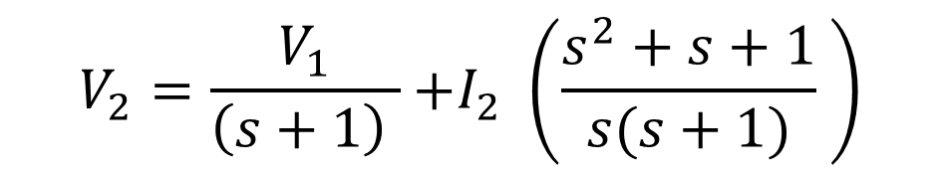
$$V_{2}=\frac{V_{1}}{\left(s+1\right) }−\frac{I_{2}}{\left(s+1\right)}+\frac{I_{2}}{s}{+I}_{2}=\frac{V_{1}}{\left(s+1\right) }{+I}_{2}+\frac{I_{2}}{s} −\frac{I_{2}}{\left(s+1\right)}$$
$$V_{2}=\frac{V_{1}}{\left(s+1\right) }{+I}_{2}+\frac{I_{2}}{s} −\frac{I_{2}}{\left(s+1\right)}=\frac{V_{1}}{\left(s+1\right) }{+I}_{2} \left(1+\frac{1}{s} −\frac{1}{\left(s+1\right)}\right)$$
$$V_{2}=\frac{V_{1}}{\left(s+1\right) }{+I}_{2} \left(\frac{s+1}{s} −\frac{1}{\left(s+1\right)}\right)=\frac{V_{1}}{\left(s+1\right) }{+I}_{2} \left(\frac{s^{2}+s+s+1−s}{s(s+1)} \right)$$
$$V_{2}=\frac{V_{1}}{\left(s+1\right) }{+I}_{2} \left(\frac{s^{2}+s+1}{s(s+1)} \right)$$
$$V_{2}=g_{21}V_{1}+ g_{22}I_{2}$$
$$V_{2}=\frac{1}{\left(s+1\right) }V_{1}+{\left(\frac{s^{2}+s+1}{s\left(s+1\right)}\right)I}_{2}$$
$g_{21}= \frac{1}{\left(s+1\right) } ,g_{22}=$ $\left(\frac{s^{2}+s+1}{s\left(s+1\right)}\right)$
$$V_{2}=g_{21}V_{1} + { g}_{22}I_{2}$$

Slide 24

$$\left[\begin{matrix}g_{11} & g_{12} \\ g_{21} & g_{22}\end{matrix}\right]=\left[\begin{matrix}\frac{1}{s+1} & −\frac{1}{s+1} \\ \frac{1}{\left(s+1\right)} & \frac{s^{2}+s+1}{s(s+1)}\end{matrix}\right]$$

